Slide 1
Kotlin OOP
Tim Teaching

Slide 2
What is OOP
OOP stands for Object-Oriented Programming.
Procedural programming: writing procedures or methods that perform operations on the data.
object-oriented programming is about creating objects that contain both data and methods.

Slide 3
Object-oriented programming has several advantages over procedural programming:
OOP is faster and easier to execute
OOP provides a clear structure for the programs
OOP helps to keep the Kotlin code DRY "Don't Repeat Yourself", and makes the code easier to maintain, modify and debug
OOP makes it possible to create full reusable applications with less code and shorter development time

Slide 4
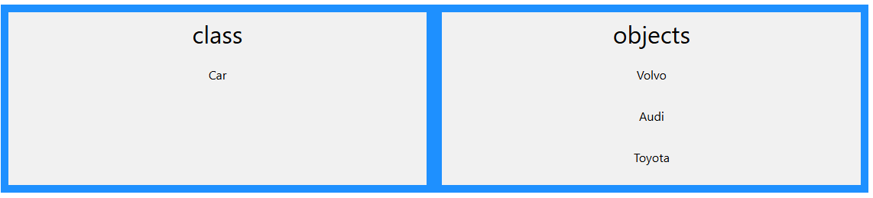
Class and Objects
class: a template for objects
object: an instance of a class

Slide 5
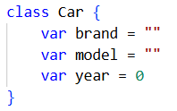
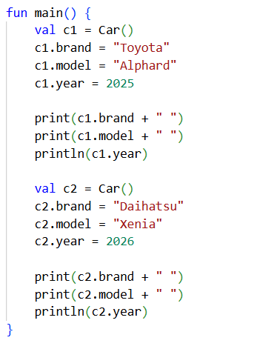

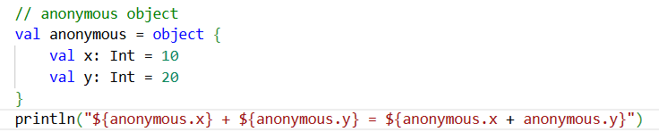

Slide 6
Constructor
A constructor is like a special function, and it is defined by using two parantheses () after the class name
You can specify the properties inside of the parantheses (like passing parameters into a regular function)
The constructor will initialize the properties when you create an object of a class
Just remember to specify the type of the property/variable
class Car2 (var brand: String, var model: String, var year: Int)

Slide 7
Inheritance
In Kotlin, it is possible to inherit class properties and functions from one class to another.
In Inheritance, there are 2 categories: superclass and subclass
superclass (parent): the class being inherited from
subclass (child): the class that inherits from another class

Slide 8
// Inheritance
// superclass
open class ParentClass {
val x = 5
}
class ChildClass: ParentClass() {
fun myFunction() {
println(x)
}
}
fun main() {
val myObj = ChildClass()
myObj.myFunction()
}

Slide 9
Encapsulation
Encapsulation is the bundling of data (properties) and methods (functions) that operate on the data into a single unit (class)
Kotlin supports encapsulation through access modifiers:
public (default): accessible from anywhere.
private: accessible only within the same class.
protected: accessible within the same class and its subclasses.
internal: accessible within the same module (a set of Kotlin files compiled together).

Slide 10
class Example {
private var privateVar: Int = 0
protected var protectedVar: Int = 0
internal var internalVar: Int = 0
var publicVar: Int = 0
}

Slide 11
Polymorphism
Polymorphism allows objects of different types to be treated as objects of a common superclass.
Method overriding: a form of polymorphism where a subclass provides a specific implementation of a method that is already defined in its superclass.
Method overloading: another form of polymorphism where multiple methods can have the same name but different parameter lists within the same class.

Slide 12
Overriding
// Base class
open class Animal {
// Method to make sound
open fun makeSound() {
println("Animal makes a sound")
}
}
// Subclass Dog inheriting from Animal
class Dog : Animal() {
// Override makeSound method
override fun makeSound() {
println("Dog barks")
}
}
fun main() {
val dog = Dog()
dog.makeSound()
}

Slide 13

Overloading
class Calculator {
fun add(a: Int, b: Int): Int {
return a + b
}
fun add(a: Int, b: Int, c: Int): Int {
return a + b + c
}
fun add(a: Double, b: Double): Double {
return a + b
}
}
fun main() {
val calculator = Calculator()
val sum1 = calculator.add(2,5)
val sum2 = calculator.add(2,5,4)
val sum3 = calculator.add(2.5,5.0)
println(sum1)
println(sum2)
println(sum3)
}

Slide 14
Abstraction
Abstraction is the concept of hiding the implementation details and showing only the necessary features of an object
In Kotlin, abstraction is achieved using abstract classes and interfaces.
Abstract classes: declared with the abstract keyword and can have abstract (unimplemented) methods.
Interfaces: define a contract for implementing classes and can contain abstract methods as well as method implementations (default methods).

Slide 15

// abstract
abstract class Shape {
abstract fun draw()
fun move() = println("Shape move")
}
class Circle : Shape() {
override fun draw() {
println("Drawing a circle")
}
}
// interface
interface Drawable {
fun draw()
}
class Square : Drawable {
override fun draw() {
println("Drawing a square")
}
}
fun main() {
val c = Circle()
c.draw()
c.move()
val s: Drawable = Square()
s.draw()
}

Slide 16
interface A {
fun hello() = println("Hello from A")
}
interface B {
fun hello() = println("Hello from B")
}
class C : A, B {
override fun hello() {
super<A>.hello() // pilih A
super<B>.hello() // pilih B
}
}
fun main() {
val c = C()
c.hello()
}

Slide 17

This Photo by Unknown Author is licensed under CC BY-NC-ND

